Slide 1
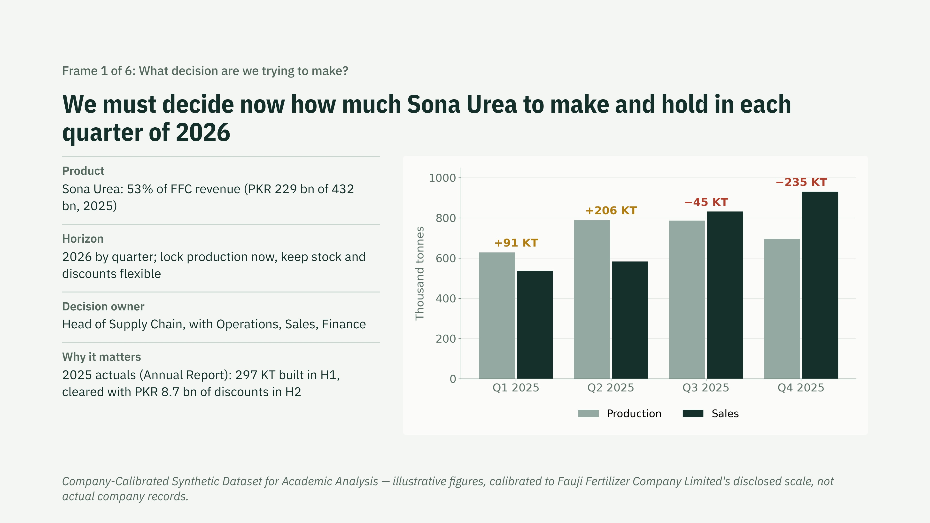
Notes:
Open with the decision, not the model. Sona Urea is half the business. Last year we produced ahead of demand in the first half, held about 300 KT, and spent PKR 8.7 billion in discounts to clear it. The question for 2026 is how much to produce and hold each quarter, and which parts of that plan we lock now versus keep flexible.

Slide 2
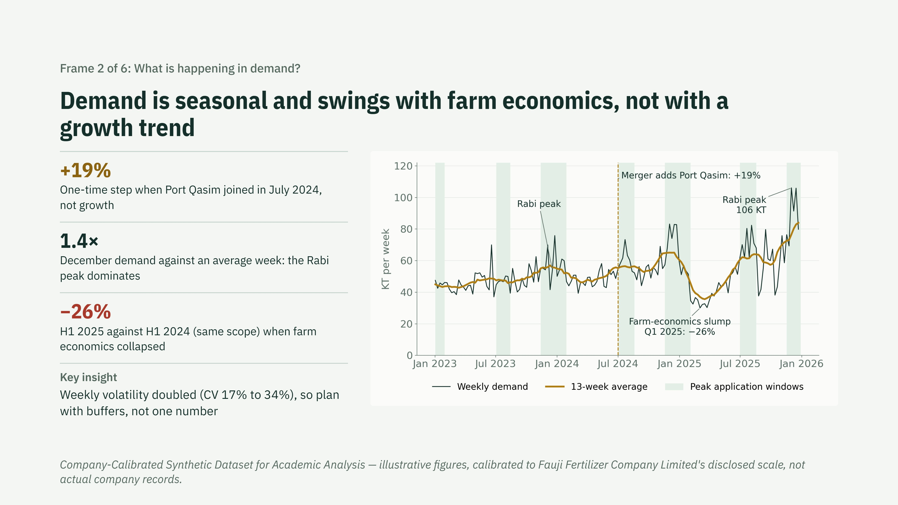
Notes:
Demand does not trend. It steps up once with the merger, peaks every Rabi season, and moves with farm economics: when wheat was not procured in 2025, demand fell by a quarter. The practical point is volatility: weekly swings doubled, so we should plan with ranges and triggers.

Slide 3
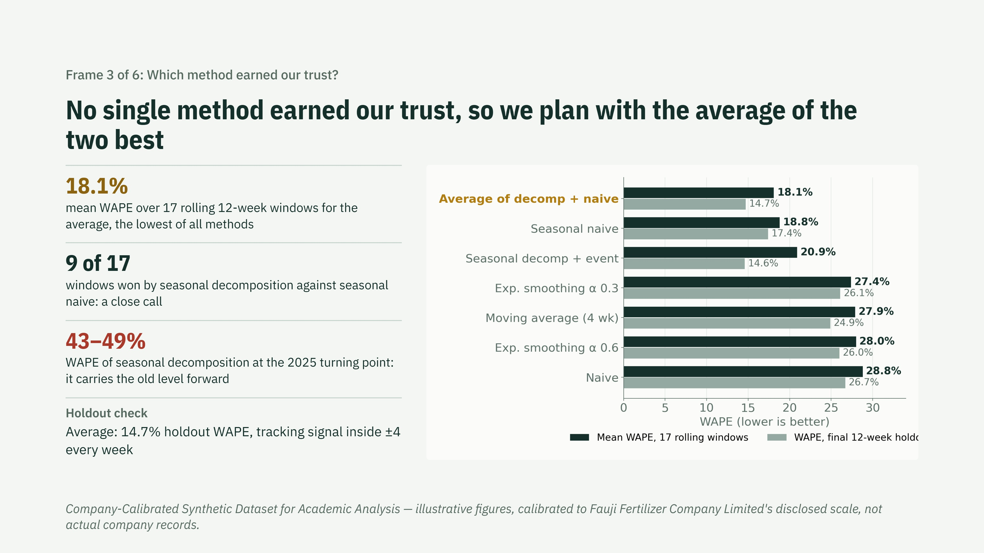
Notes:
I first chose seasonal decomposition because it won the final 12-week holdout. An independent audit re-ran the test over 17 rolling windows: decomposition won only 9, and it failed badly when demand turned in early 2025. Seasonal naive is steadier but misses level changes. Their average has the lowest error and bias across all windows, so that is the forecast we plan with. The holdout was also reused to compare variants, which is why the rolling windows are the main evidence.

Slide 4
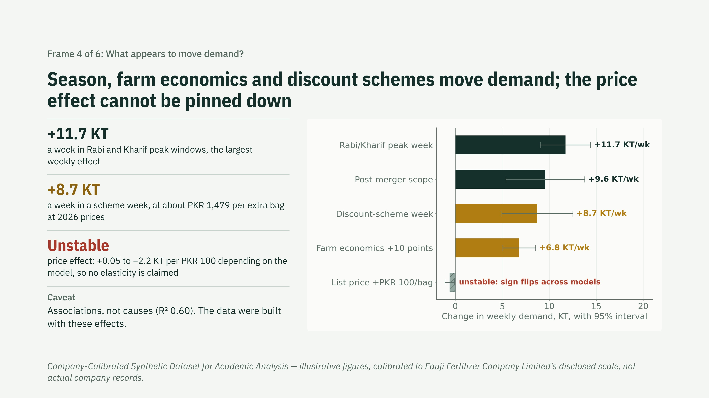
Notes:
The calendar and farm economics drive volume. Schemes move volume but cost about PKR 1,479 for every extra bag, so they are a stock-clearing tool. The synthetic data were built with these effects, so the regression checks the method, not FFC's market. Price is the honest weak spot: its coefficient changes sign depending on which weeks and controls are used, so I do not quote an elasticity. Residuals are autocorrelated; corrected standard errors keep the other drivers significant.

Slide 5
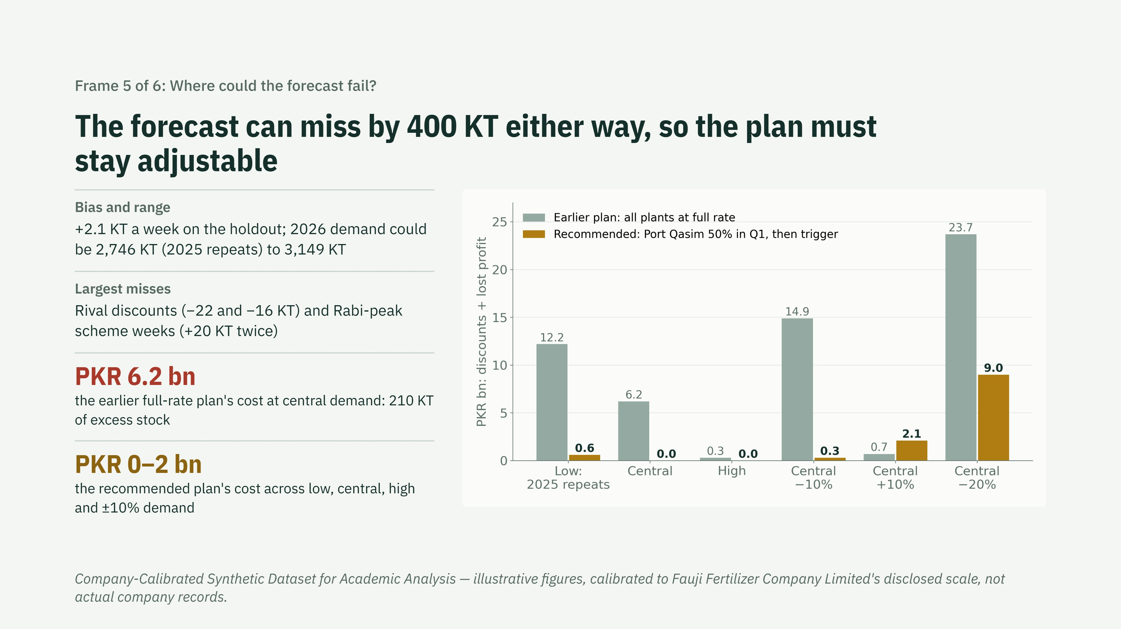
Notes:
The audit showed our central forecast was too high and that capacity and opening stock are unverified. Rather than bet on one number, the plan holds Port Qasim at 50% in Q1 and sets its rate from April on actual Q1 demand. Across the realistic range that keeps the cost of being wrong to about two billion rupees, against six to fifteen billion for the old full-rate plan. Only a 20% slump still hurts.

Slide 6
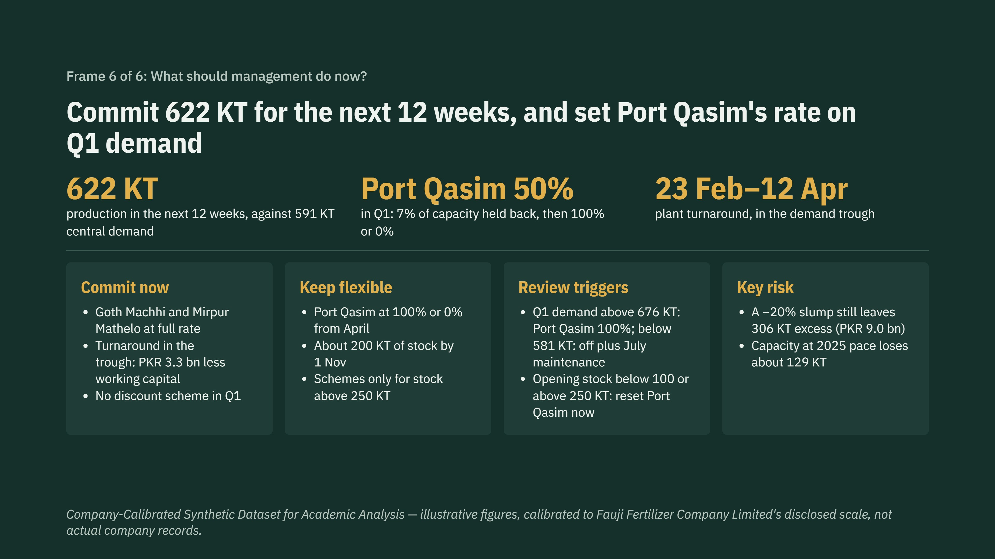
Notes:
Here is the revised ask after the audit. Run Goth Machhi and Mirpur Mathelo at full rate, hold Port Qasim at half rate through March, and take the turnaround in the February to April trough. That gives 622 KT over the next 12 weeks against central demand of 591 KT. At the end of March, if Q1 sales run more than 7.5% above forecast, Port Qasim goes to full rate; if more than 7.5% below, it stops and we add a July maintenance window. Before any of that, confirm the real opening stock and plant capacity, because both change the answer.

